Slide 1
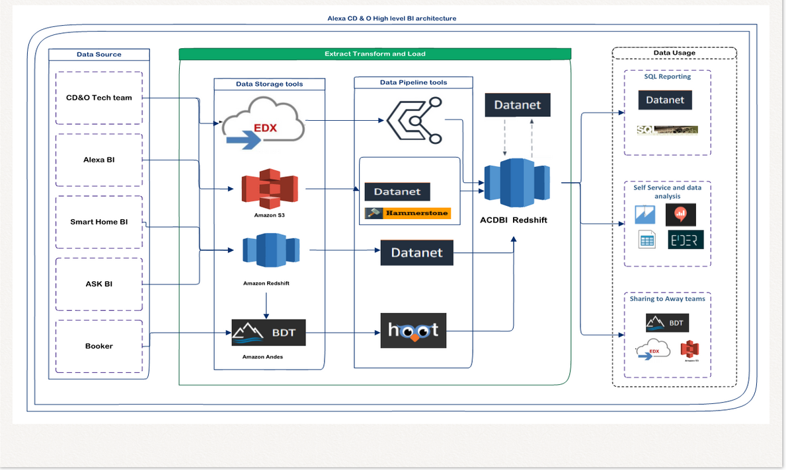
Vision
Notes:
We want the ability to store the data
We want the ability to source the data CDO logs into systems

